Slide 1

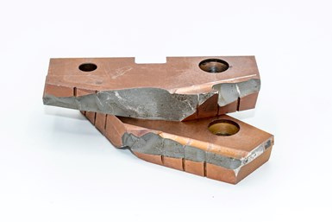
ME 623 : Group Project
PREDICTIVE TOOL FAILURE ANALYSIS USING MACHINE LEARNING
Presented By :
Ayush Ranjan(210103028)
Ankit Gurwan(210103016)
Ayush Kotarya(210103027)
Presented To :
Prof. R.K. Mittal

Slide 2
2
OVERVIEW
Introduction
Training the Model
Data collection and Preprocessing
Testing the Model
Model Selection
Analysis and Conclusion
IIT Guwahati | 2024

Slide 3
3
INTRODUCTION
Machine failure prediction using machine learning has the potential to be an invaluable tool for any business that regularly uses and maintains machinery. By leveraging predictive analytics, companies can proactively identify and take care of possible losses before they occur, decreasing costly downtime.
Security increased
Efficient prices
IIT Guwahati | 2024

Slide 4
FACTORS
4
Type
Process Temperature
Consisting of a letter L, M, or H for Low, Medium and High as product quality variants.
Generated using a random walk process normalized to a standard deviation of 1 K, added to the air temperature plus 10 K.
Air Temperature (K)
Rotational Speed (rpm)
Generated using a random walk process later normalized to a standard deviation of 2 K around 300 K.
Calculated from a power of 2860 W, overlaid with a normally distributed noise.

Slide 5
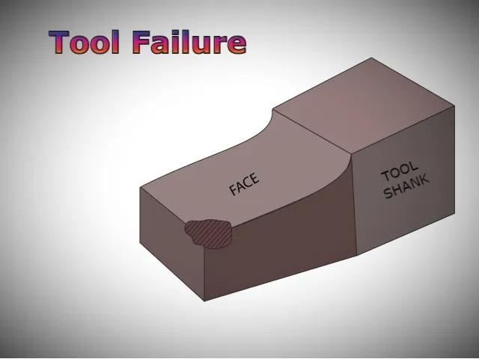
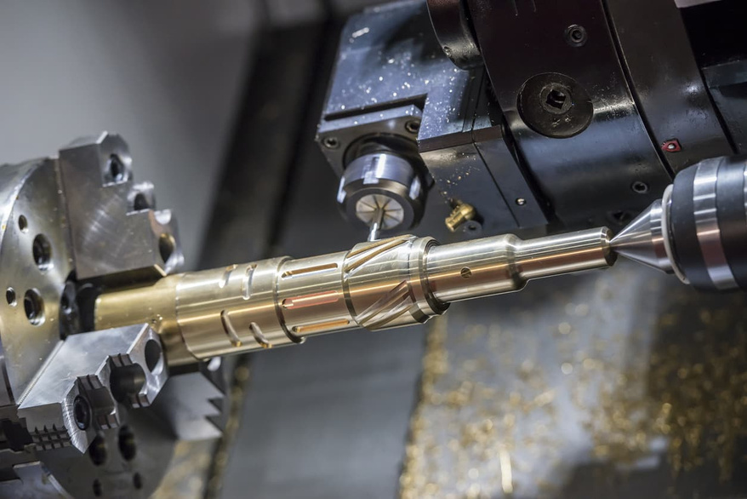
CONTINUED.....
5
Torque
Tool Wear
Torque values are normally distributed around 40 Nm with a
Ïƒ = 10 Nm and no negative values.
The quality variants H/M/L add 5/3/2 minutes of tool wear to the used tool in the process.

Slide 6
MODES OF FAILURE
6
Machine failure consists of five independent failure modes:
Tool wear failure (TWF)
Heat dissipation failure (HDF)
Power failure (PWF)
Overstrain failure (OSF)
If at least one of the above failure modes is true, the process fails and the 'machine failure' label is set to 1.

Slide 7
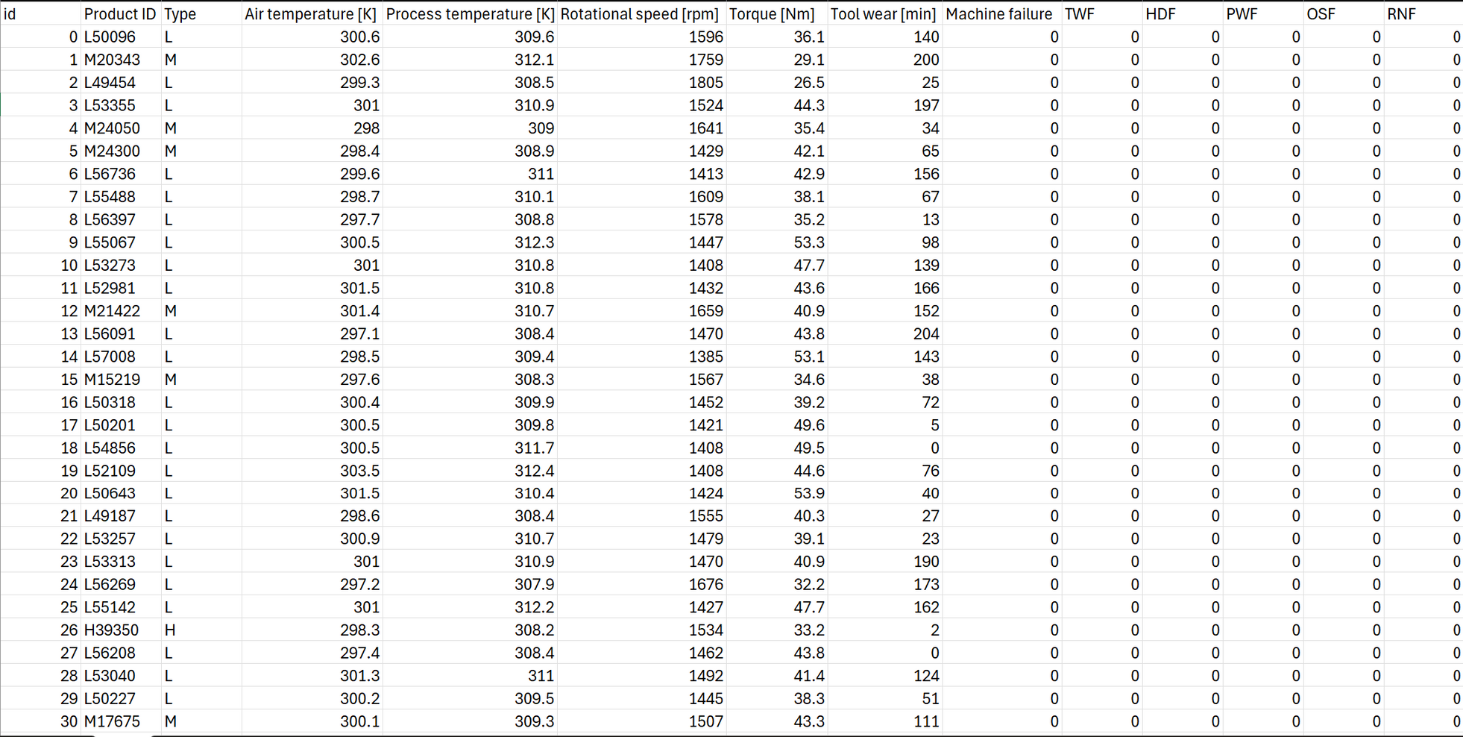
RAW DATA COLLECTION
7
This synthetic dataset is modeled after an existing milling machine.

Slide 8
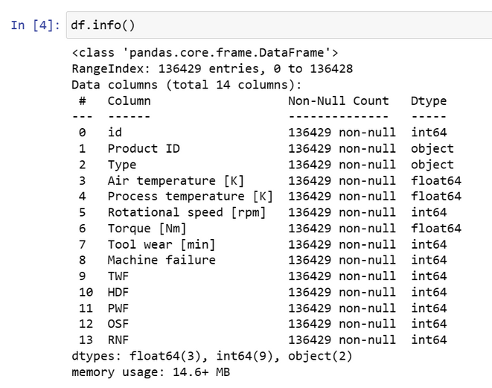
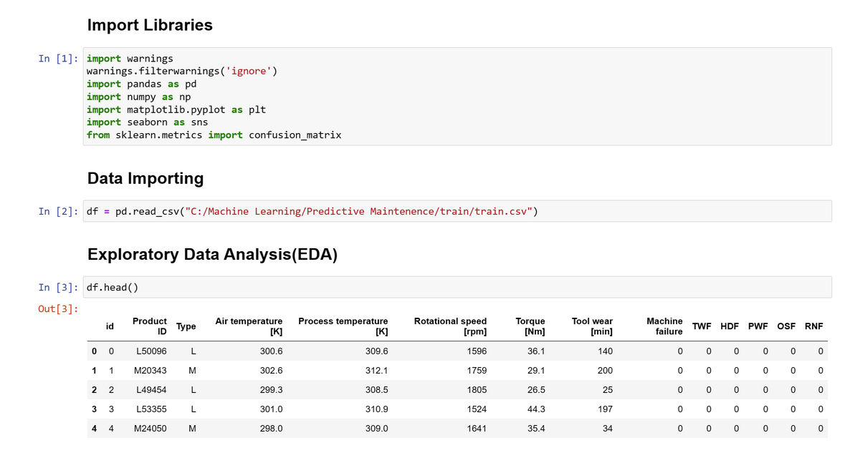
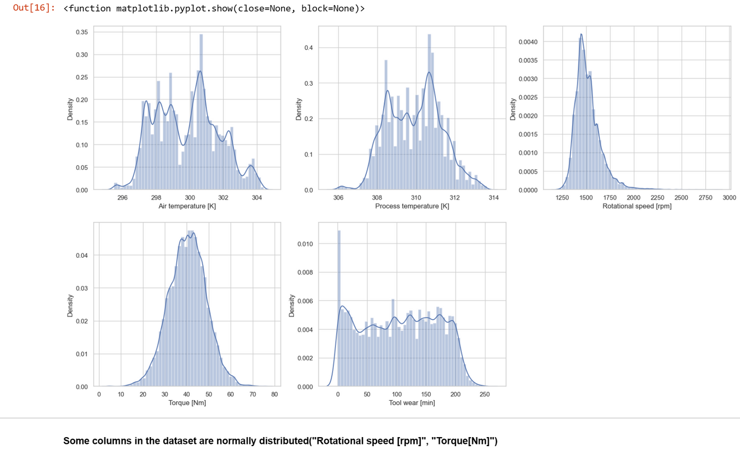
DATA COLLECTION AND PRE PROCESSING
8
DATAFRAME
INFORMATION
Distribution plot of main features to visualize the data

Slide 9
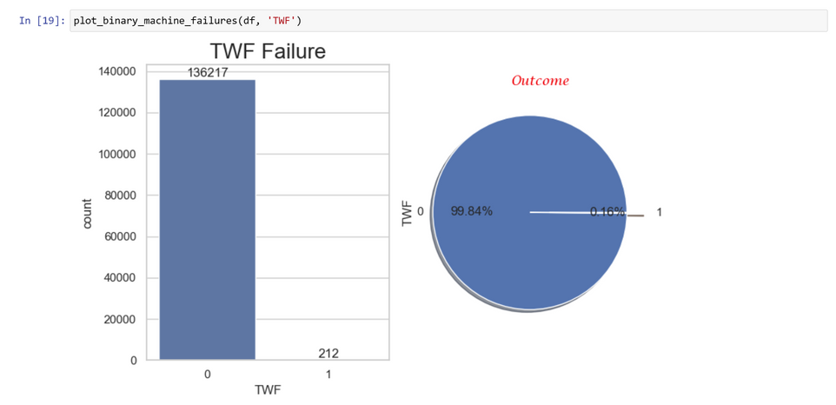
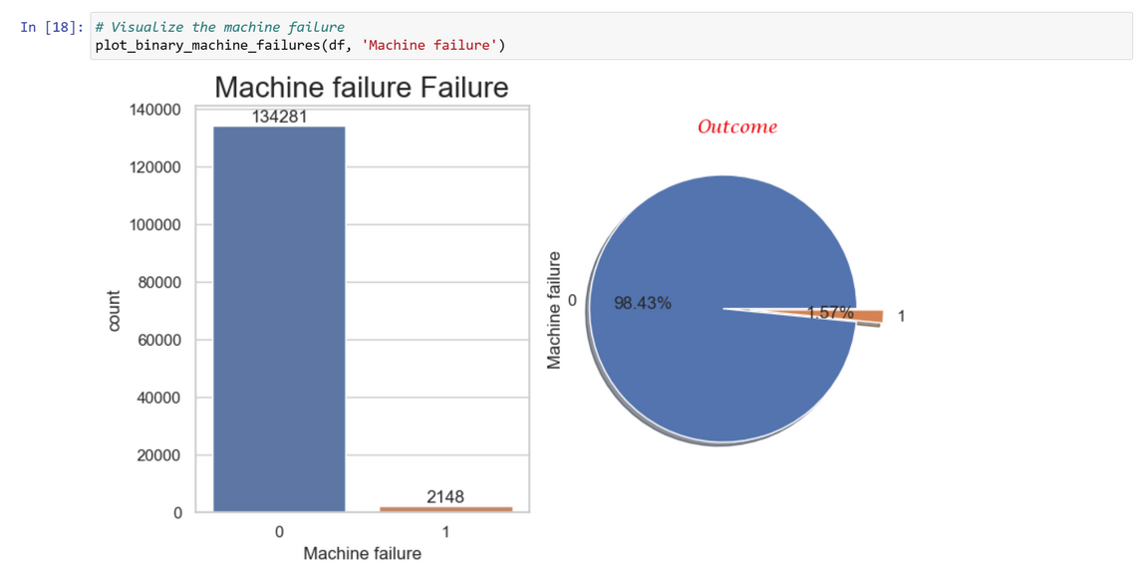
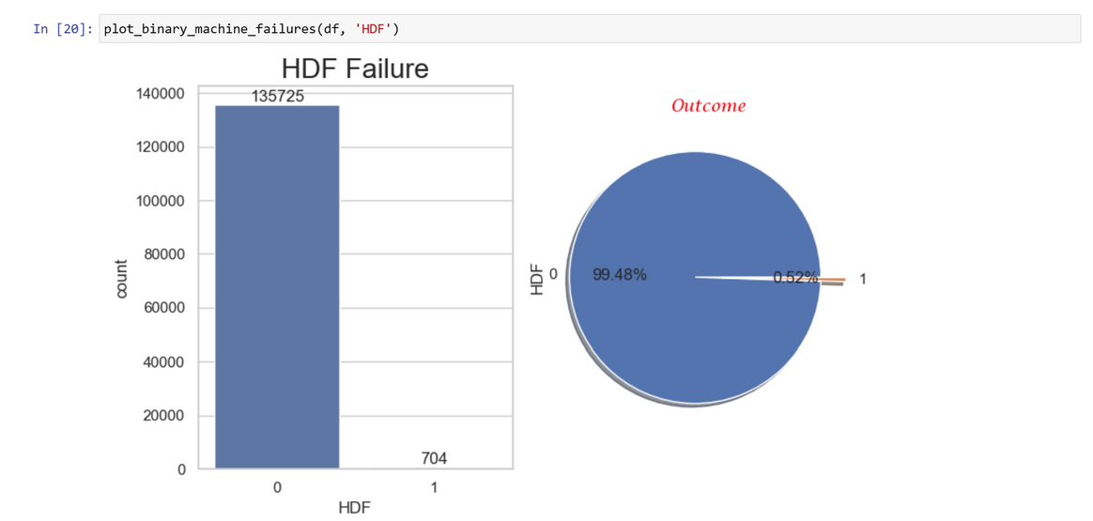
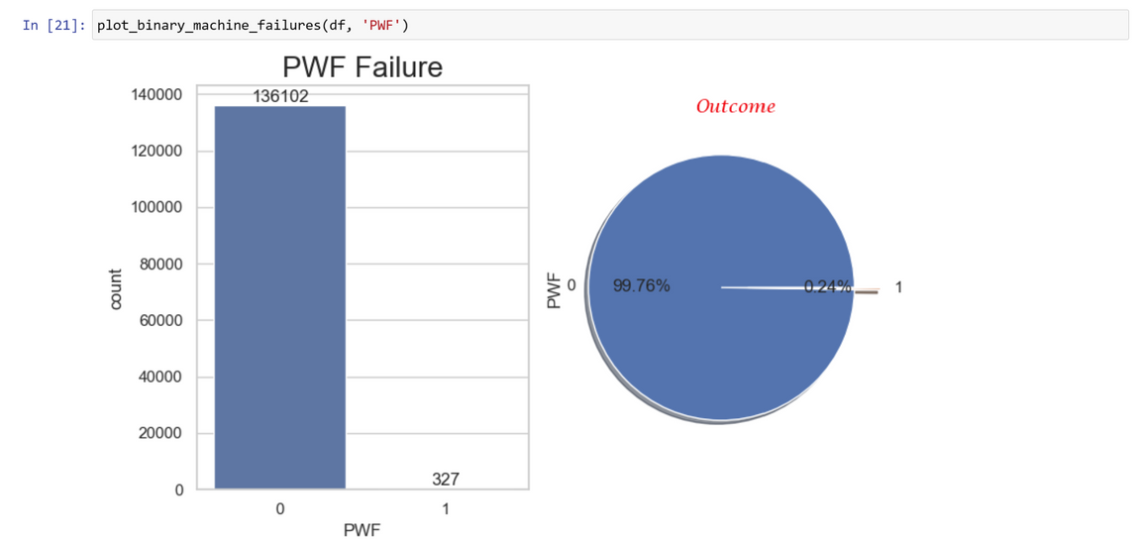
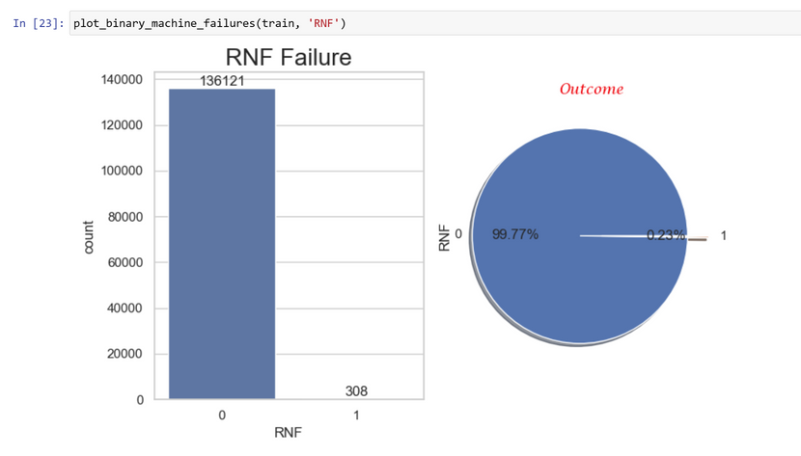
VISUALIZING THE
FAILURES
9

Slide 10
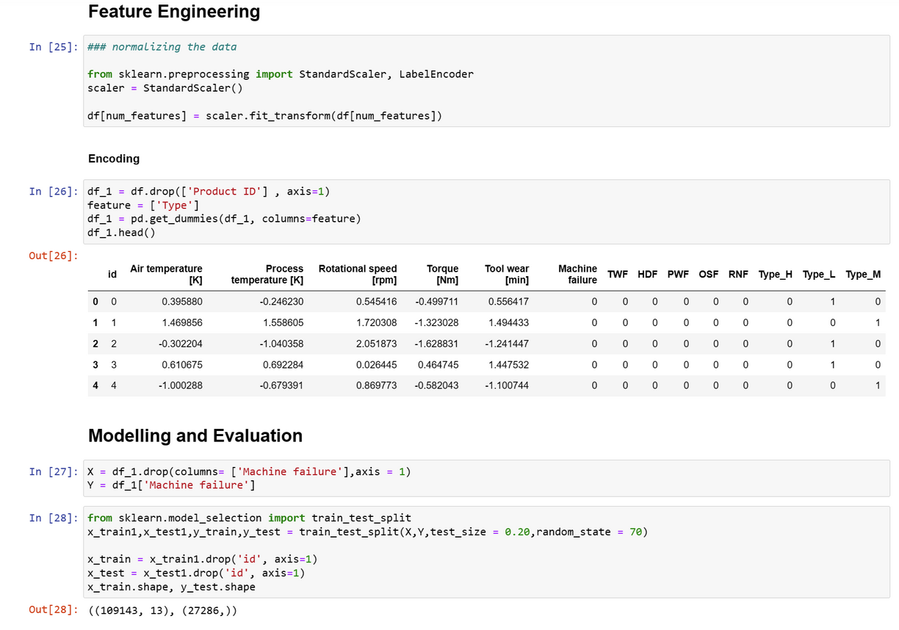
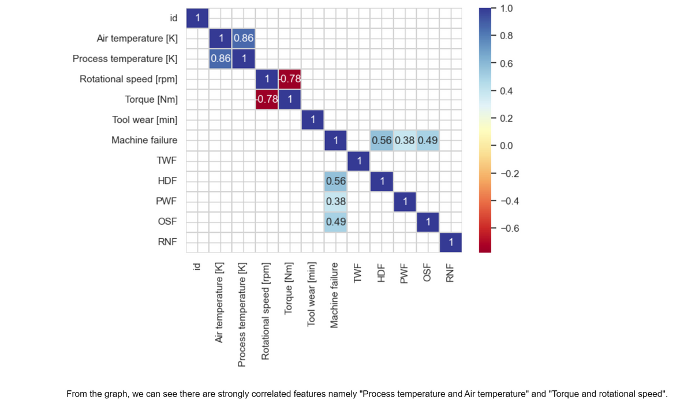
FEATURE ENGINEERING
10

Slide 11
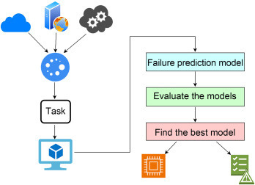
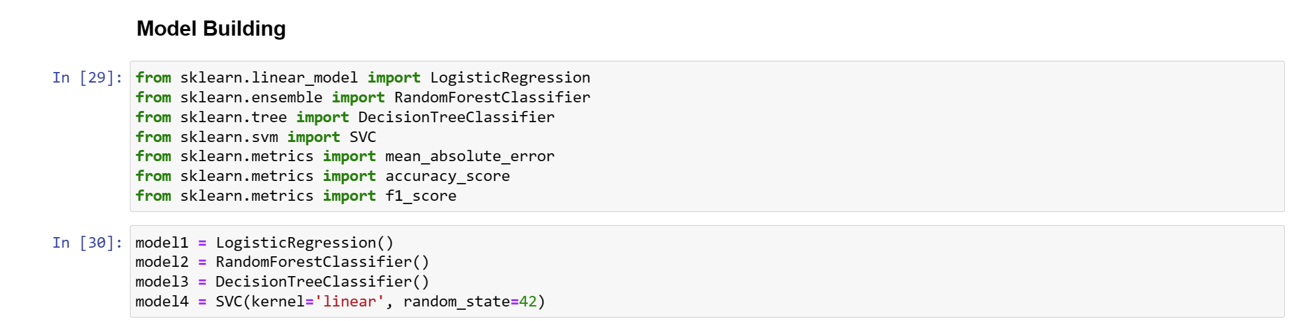
MODEL SELECTION
11
Models used :
Logistic Regression
Random Forest
Decision Tree
Support Vector Machine

Slide 12
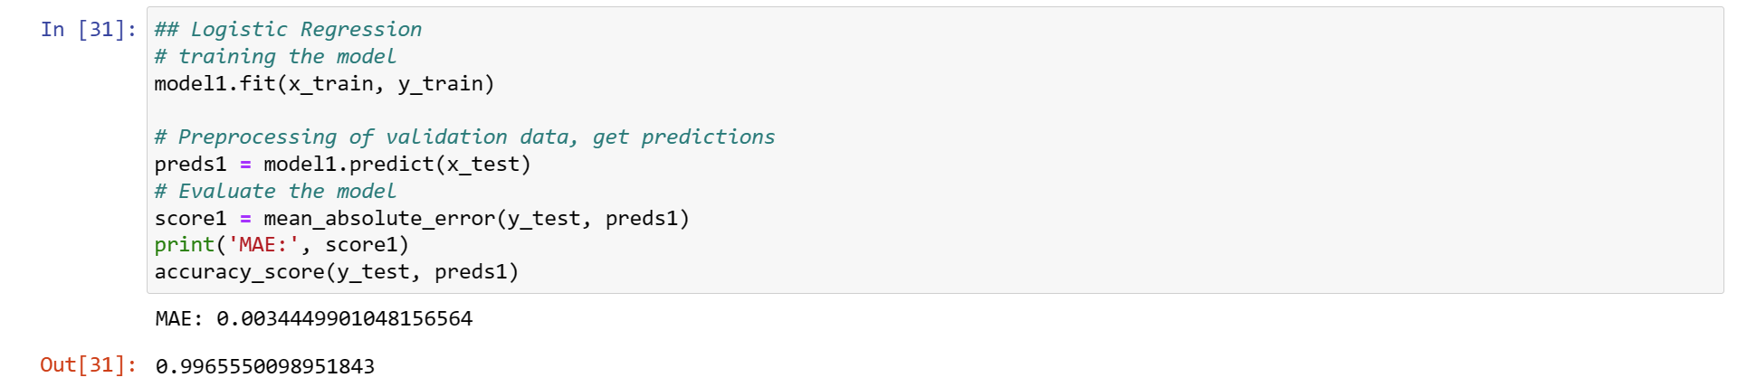
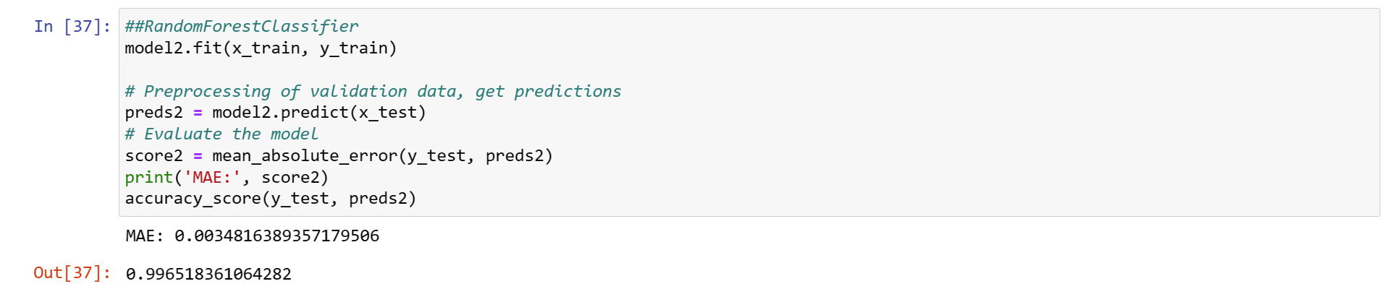
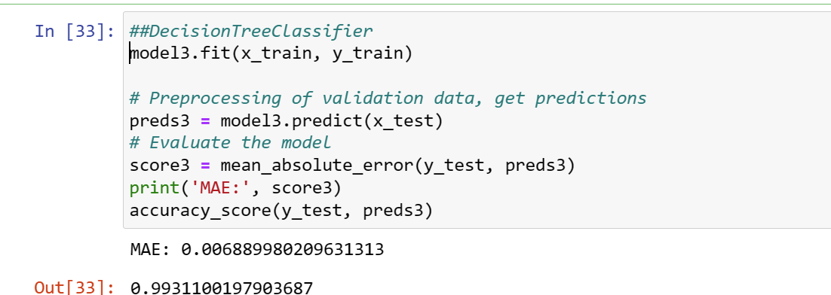
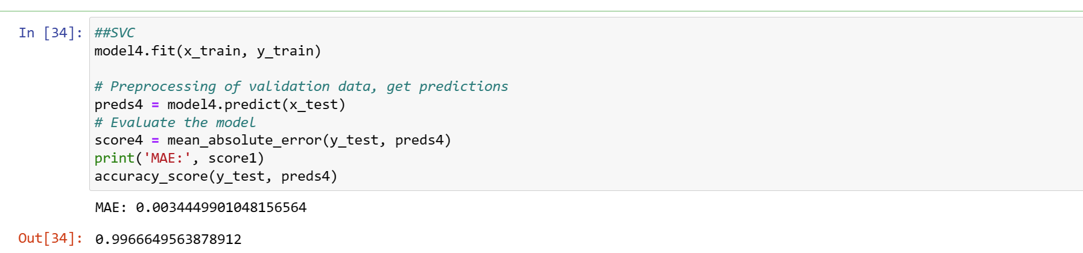
TRAINING AND TESTING THE MODEL
12

Slide 13
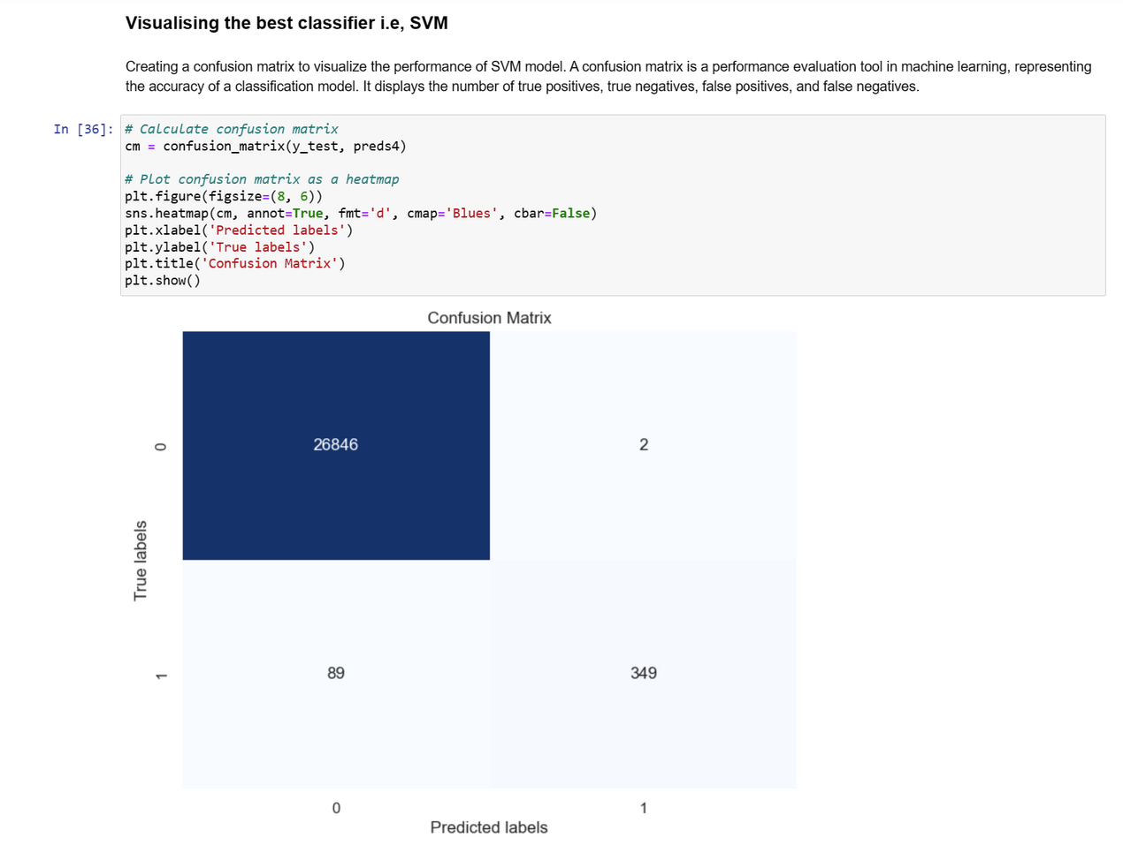
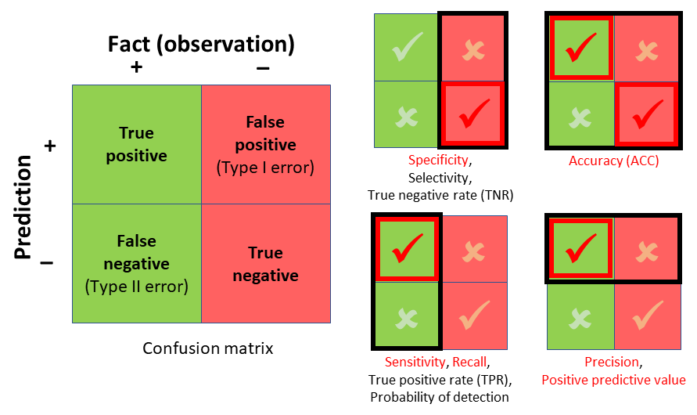
VISUALIZING THE BEST MODEL
13
SVM
SVM, or Support Vector Machines, are sophisticated machine learning models known for their effectiveness in classification tasks. They excel at finding optimal decision boundaries between classes, even in high-dimensional data spaces. SVMs are versatile, capable of handling both linear and non-linear relationships through the use of kernel functions. Their robustness to overfitting, suitability for high-dimensional data, and applications across various domains make SVMs a go-to choice for many machine learning practitioners.
Confusion Matrix

Slide 14
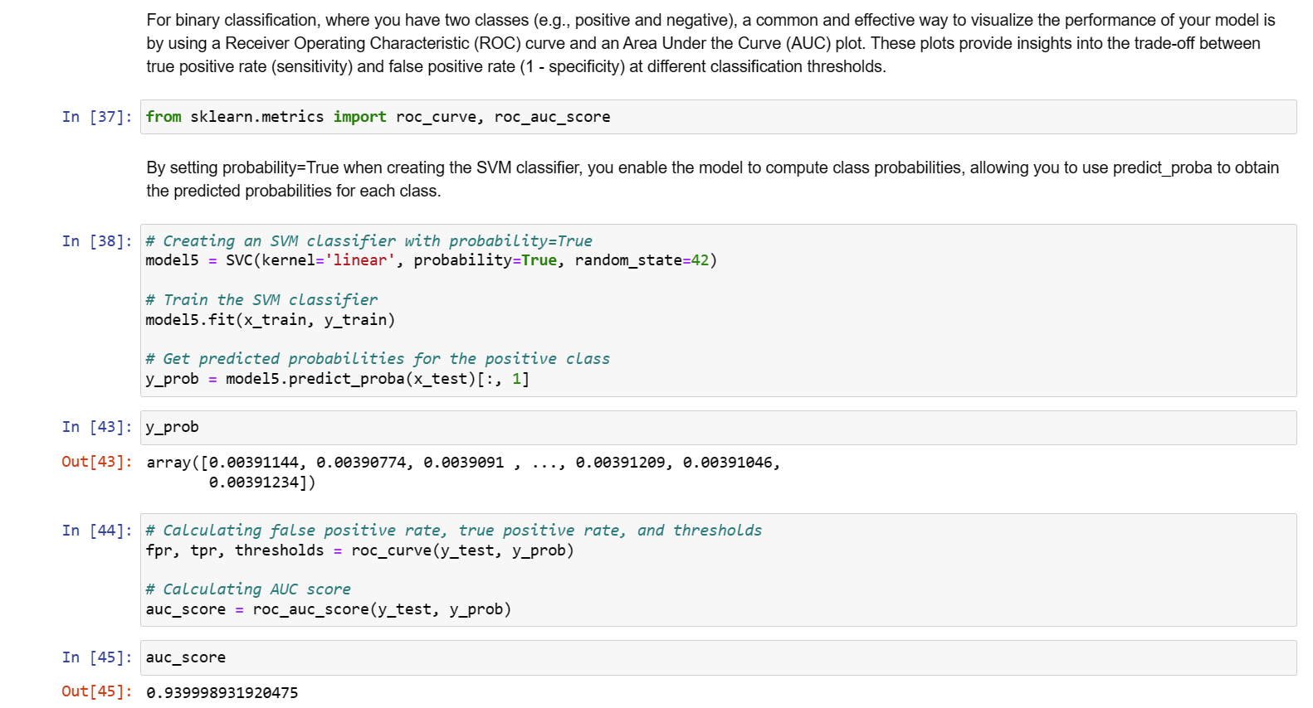
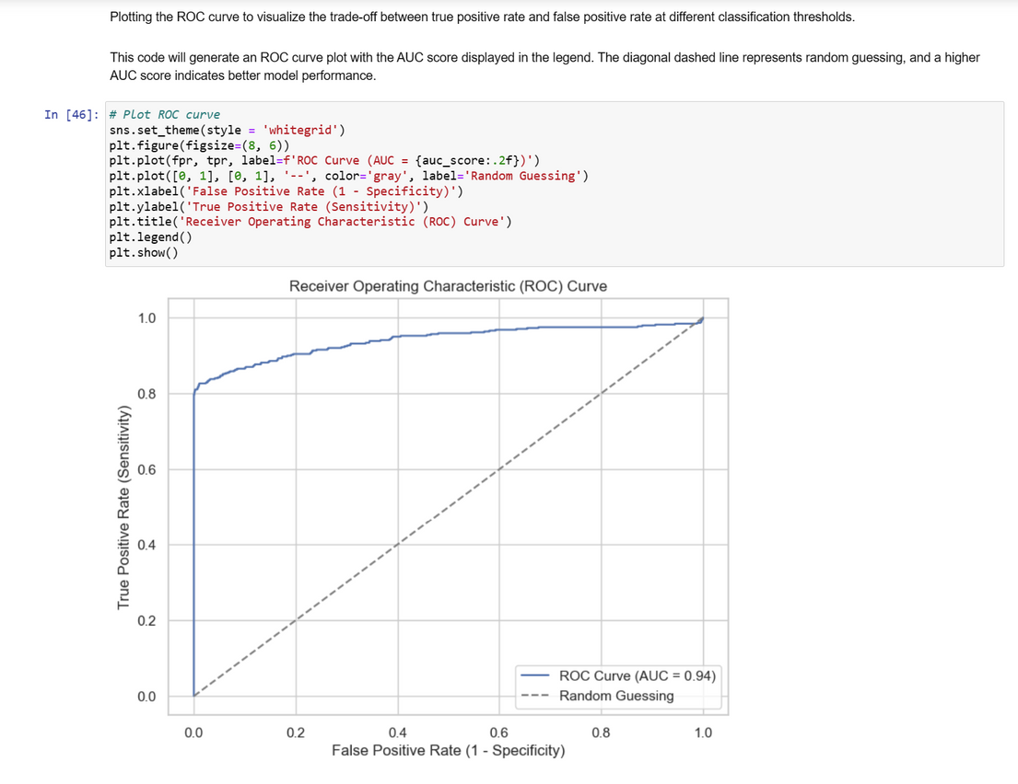
CONTINUED....
14

Slide 15
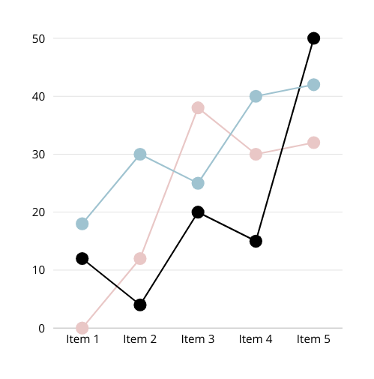
﻿RESULT
15
High Accuracy: The high accuracy of 99.66% suggests that the SVM model is highly effective in correctly classifying instances into their respective classes (failure or non-failure).
Minimal False Positives: While there are a few false positives (FP = 2), they represent a small fraction of the total negative instances.
Model Reliability: The high accuracy and low false negative rate suggest that the SVM model is reliable and can be trusted for predictive tool failure analysis.
IIT Guwahati | 2024

Slide 16
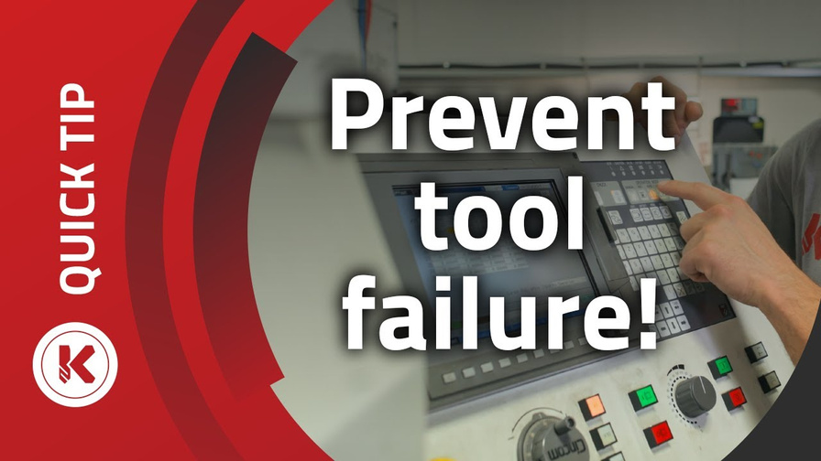
16
CONCLUSION
Implementing predictive tool failure analysis through machine learning offers substantial advantages for industrial operations. By leveraging advanced algorithms and sensor data, organizations can forecast potential tool failures, enabling proactive maintenance strategies that minimize downtime, reduce costs, and optimize productivity.
Github link of the model: https://github.com/ayushranjan17/Predictive-Maintenance.git

Slide 17
17
REFERENCES
Data from : Kaggle Website
Link: https://www.kaggle.com/competitions/playground-series-s3e17/data?select=train.csv
https://indatalabs.com/blog/machine-failure-prediction-machine-learning#:~:text=Machine%20failure%20prediction%20using%20machine%20learning%20has%20the%20potential%20to,they%20occur%2C%20decreasing%20costly%20downtime.
IIT Guwahati | 2024

Slide 18
IIT Guwahati | 2024
THANK YOU

